Slide 1

SDET Course
Design Patterns - Command

Slide 2
3 Types of Design Patterns
Creational
Singleton
Builder
Prototype
Factory Method
Abstract Factory
Structural
Adapter
Composite
Proxy
Flyweight
Bridge
Facade
Decorator
Behavioral
Strategy
Observer
Command
Memento
State
Template Method
Mediator
Chain of Responsibility
Interpreter
Visitor
Iterator

Slide 3
Agenda
Description
Diagram
Code sample (Java)
Use cases

Slide 4

Description
Introduction - Order Slip in a Restaurant

Slide 5
Description
The Command design pattern is a behavioral design pattern that encapsulates a request as an object, thereby allowing users to parameterize clients with queues, requests, and operations. It involves three main components: the command, the receiver, and the invoker. The command component specifies the action to be taken, the receiver is the object that performs the action, and the invoker is the object that knows how to execute the command. This separation of concerns enables decoupling between the objects that send the requests and the objects that receive and execute those requests. By encapsulating a request as an object, it allows for the storage, queuing, and logging of requests, and also provides the capabilities to support undoable operations. The Command pattern is particularly useful in scenarios where actions need to be triggered as a response to a certain event, executed in a specific order, or executed later on.

Slide 6
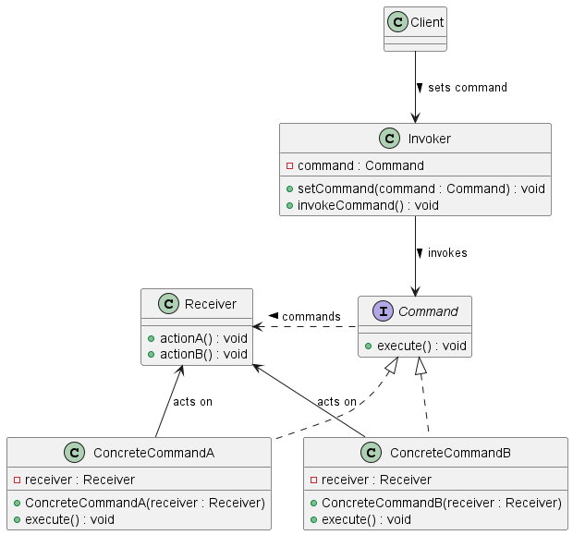
Class Diagram

Slide 7
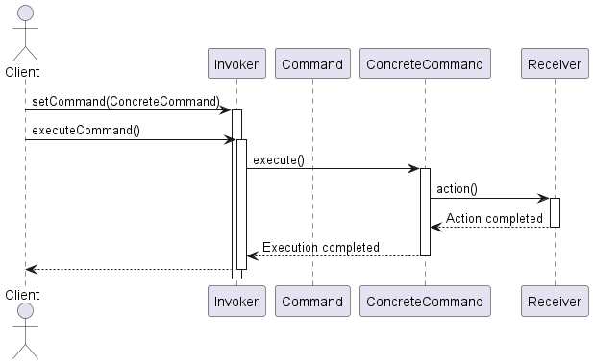
Sequence Diagram

Slide 8
Code Sample

Slide 9
Use cases
General
GUI Button Commands
Task Scheduling and Background Operations
Integration with Smart Home Devices
In Test Automation
Dynamic Test Workflows (Cucumber)
Batch Testing
API Testing
Testing Server

Slide 10

What is Cucumber BDD
Cucumber BDD is a software development approach that enhances communication, collaboration, and requirements understanding through the use of simple, domain-specific language.
It enables the creation of executable specifications written in plain language, allowing stakeholders to understand how software behaves without needing to read code.
Cucumber supports behavior-driven development (BDD) by allowing the definition of application behavior in natural language, bridging the gap between business professionals and developers.

Slide 11
Cucumber BDD Example
public class SearchGoogleSteps {
WebDriver driver;
@Given("I open Google")
public void i_open_google() {
driver = new ChromeDriver();
driver.get("https://www.google.com");
}
@When("I search for {string}")
public void i_search_for(String query) {
WebElement searchBox = driver.findElement(By.name("q"));
searchBox.sendKeys(query);
searchBox.submit();
}
@Then("I should see results related to {string}")
public void i_should_see_results_related_to(String query) {
WebElement resultStats = driver.findElement(By.id("result-stats"));
assert resultStats.isDisplayed();
driver.quit();
}
}
Feature: Google Search
Scenario: Searching on Google
Given I open Google
When I search for "Cucumber BDD"
Then I should see results related to "Cucumber BDD"

Slide 12
Happy Coding

